Slide 1



KONGU ENGINEERING COLLEGE
PERUNDURAI ERODE-638060
DEPARTMENT OF CSD
Smartprint Hub
PROJECT GUIDE
Dr.K.R Prasannakumar
PROJECT MEMBERS
SATHEESH K - 22CDR089
PRAVEEN KUMAR C - 22CDR073
NAGULAN D - 22CDR059

Slide 2
OBJECTIVE
To develop a fast and efficient file-sharing system for photocopy shops.
To eliminate dependency on Gmail, WhatsApp, and other apps.
To enable offline file transfer, reducing network costs.
To provide better file management for shop owners.
To track Xerox count and revenue efficiently.
To ensure a secure and hassle-free file-sharing experience.

Slide 3
TECHNOLOGIES
Frontend:
React.js – For building the interactive and user-friendly customer and shop UI.
Backend:
Node.js – Server-side logic and file handling.
Express.js – Routing and API management.
Real-time Communication:
WebSocket (Socket.IO) – For instant file transfers and live queue updates.
Desktop App Packaging:
Electron.js – For bundling the system into a cross-platform desktop application for shop owners.
Networking:
Local Wi-Fi (No Internet Needed) – Enables file transfer and communication over LAN.

Slide 4
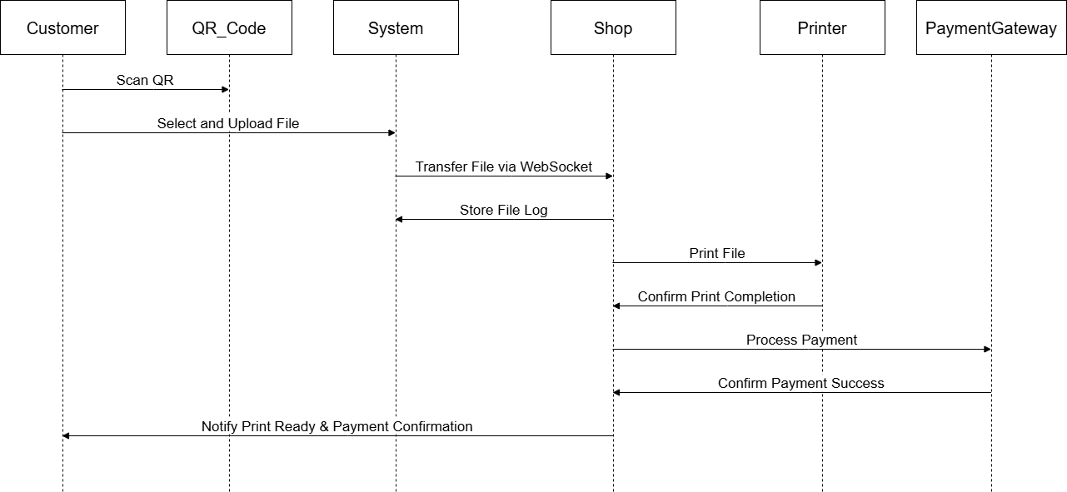
WORKFLOW

Slide 5
MODULE DESCRIPTION
QR Code-based Connection Module
Instant File Transfer Module
Offline Support Module
Queue Management Module
Shop Owner Control Panel
Xerox Count & Billing Module
File History & Reprint Module
Easy Setup & Deployment Module
Local Storage & Security Module

Slide 6
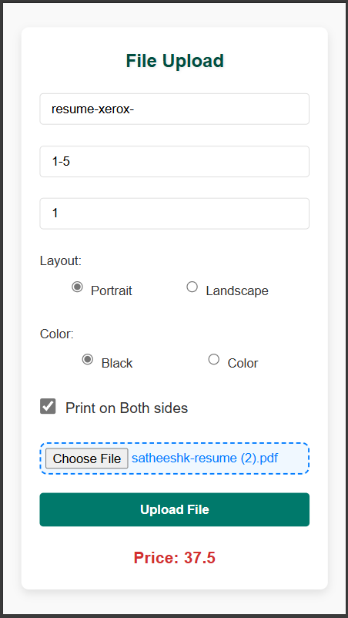
IMPLEMENTATION

Slide 7
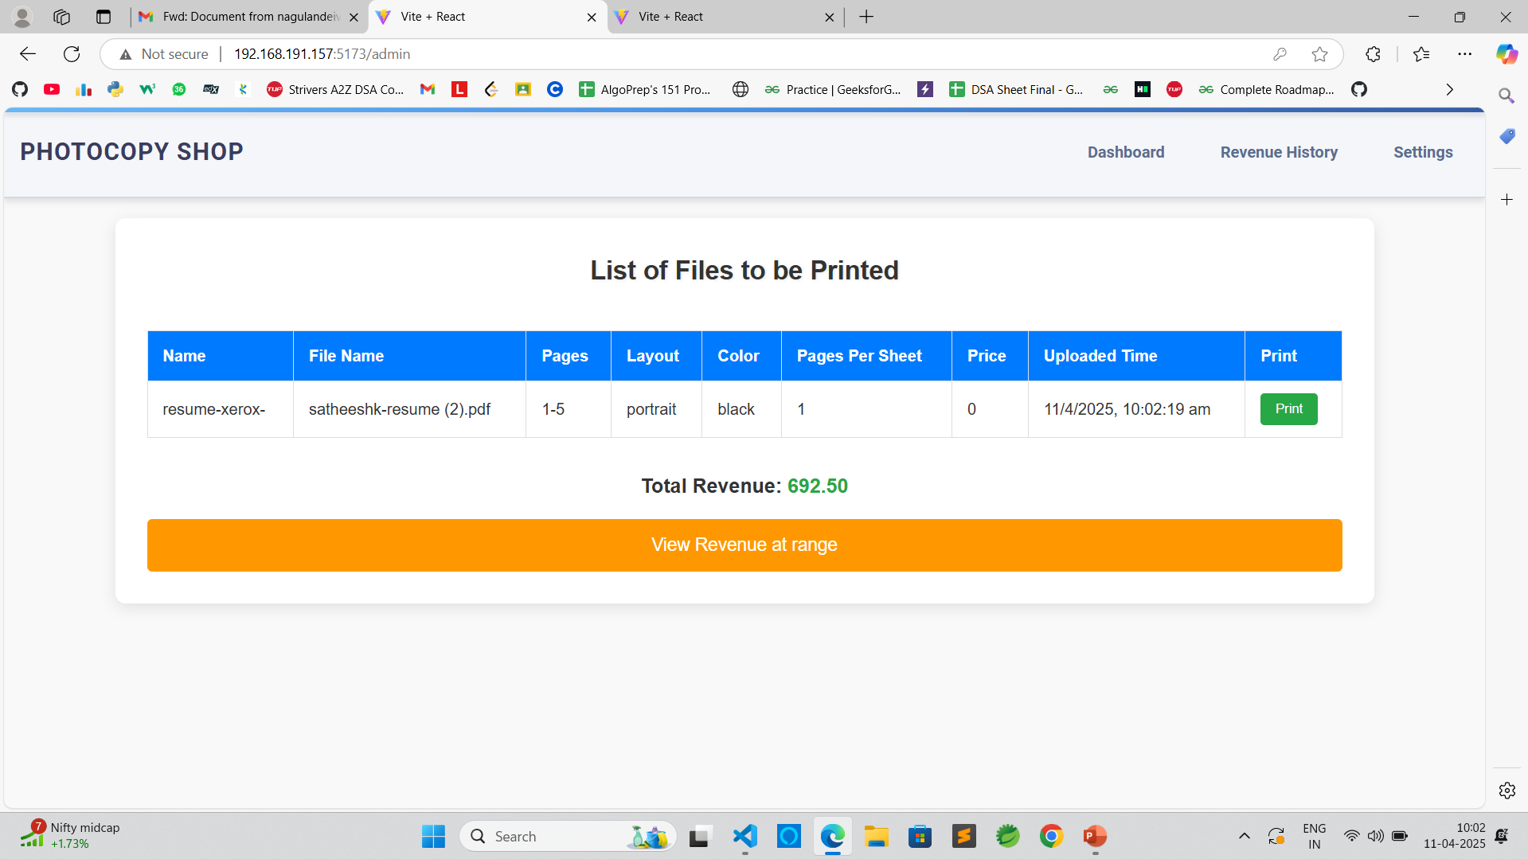
IMPLEMENTATION

Slide 8
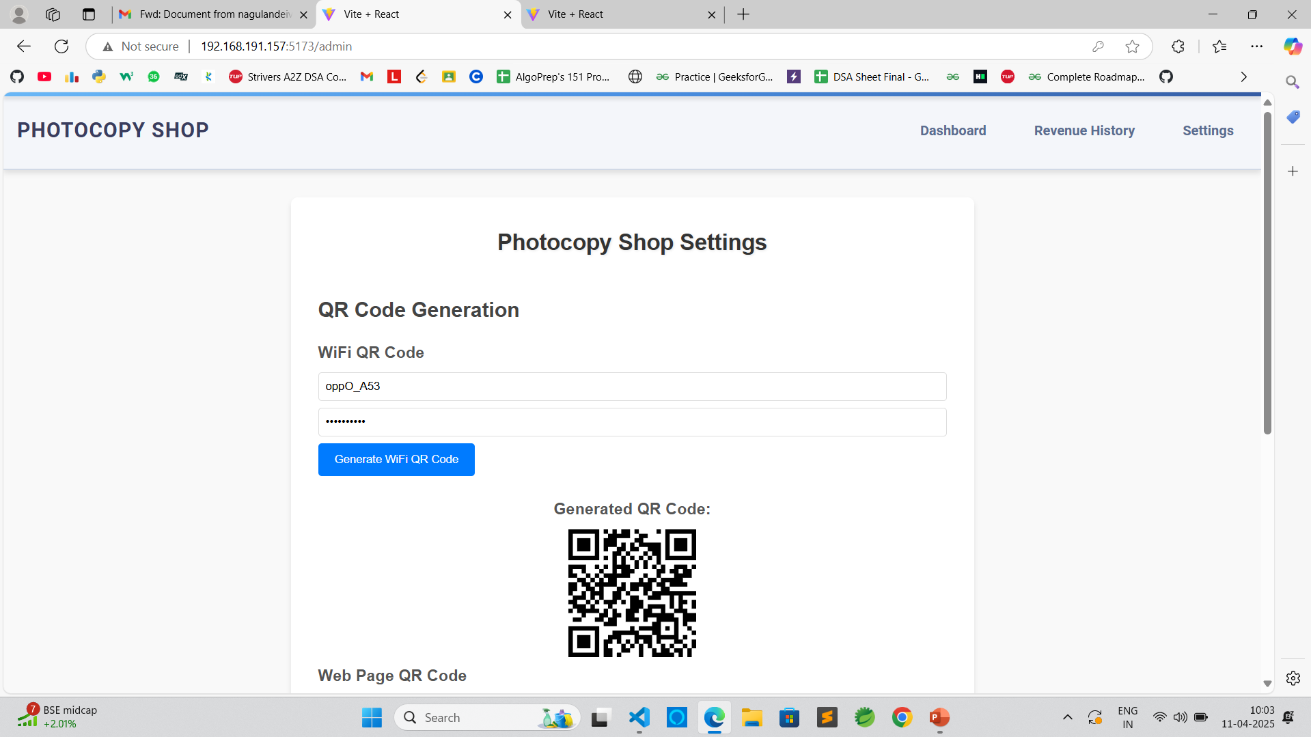
IMPLEMENTATION

Slide 9
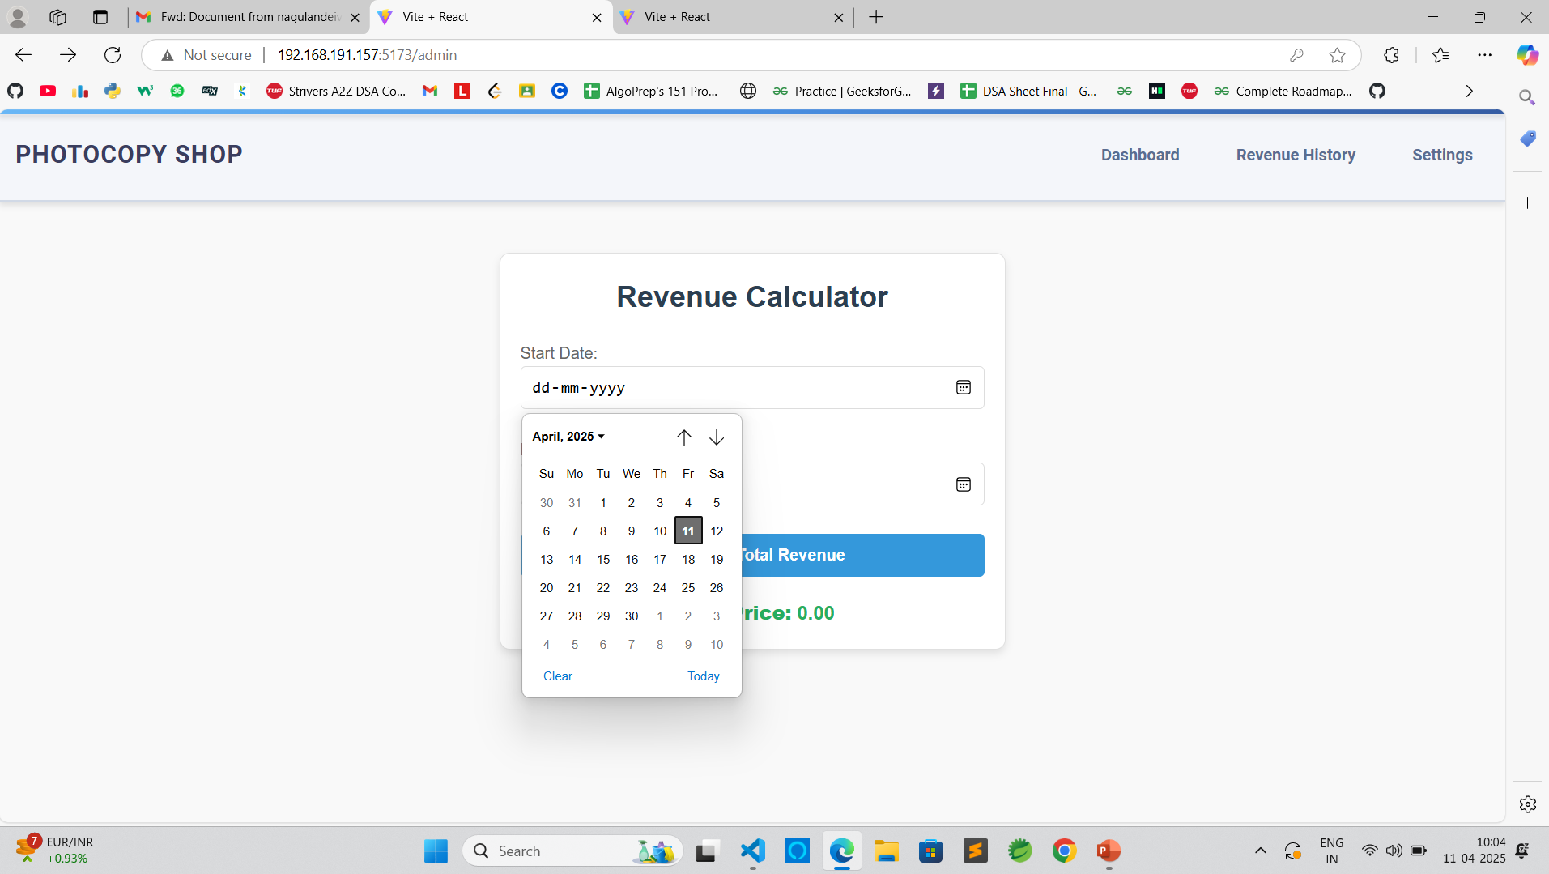
IMPLEMENTATION

Slide 10
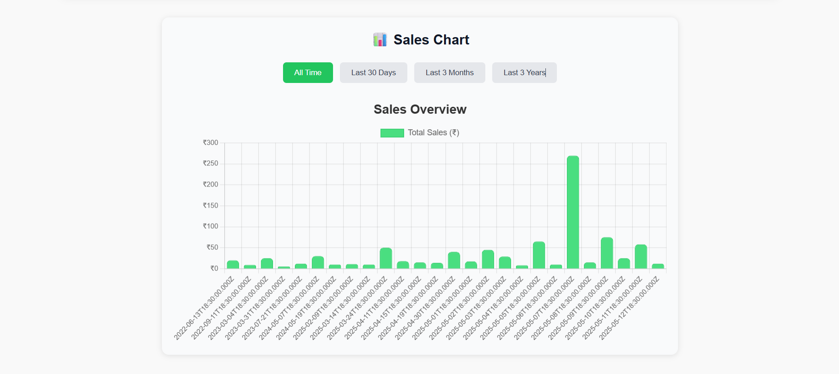
IMPLEMENTATION

Slide 11
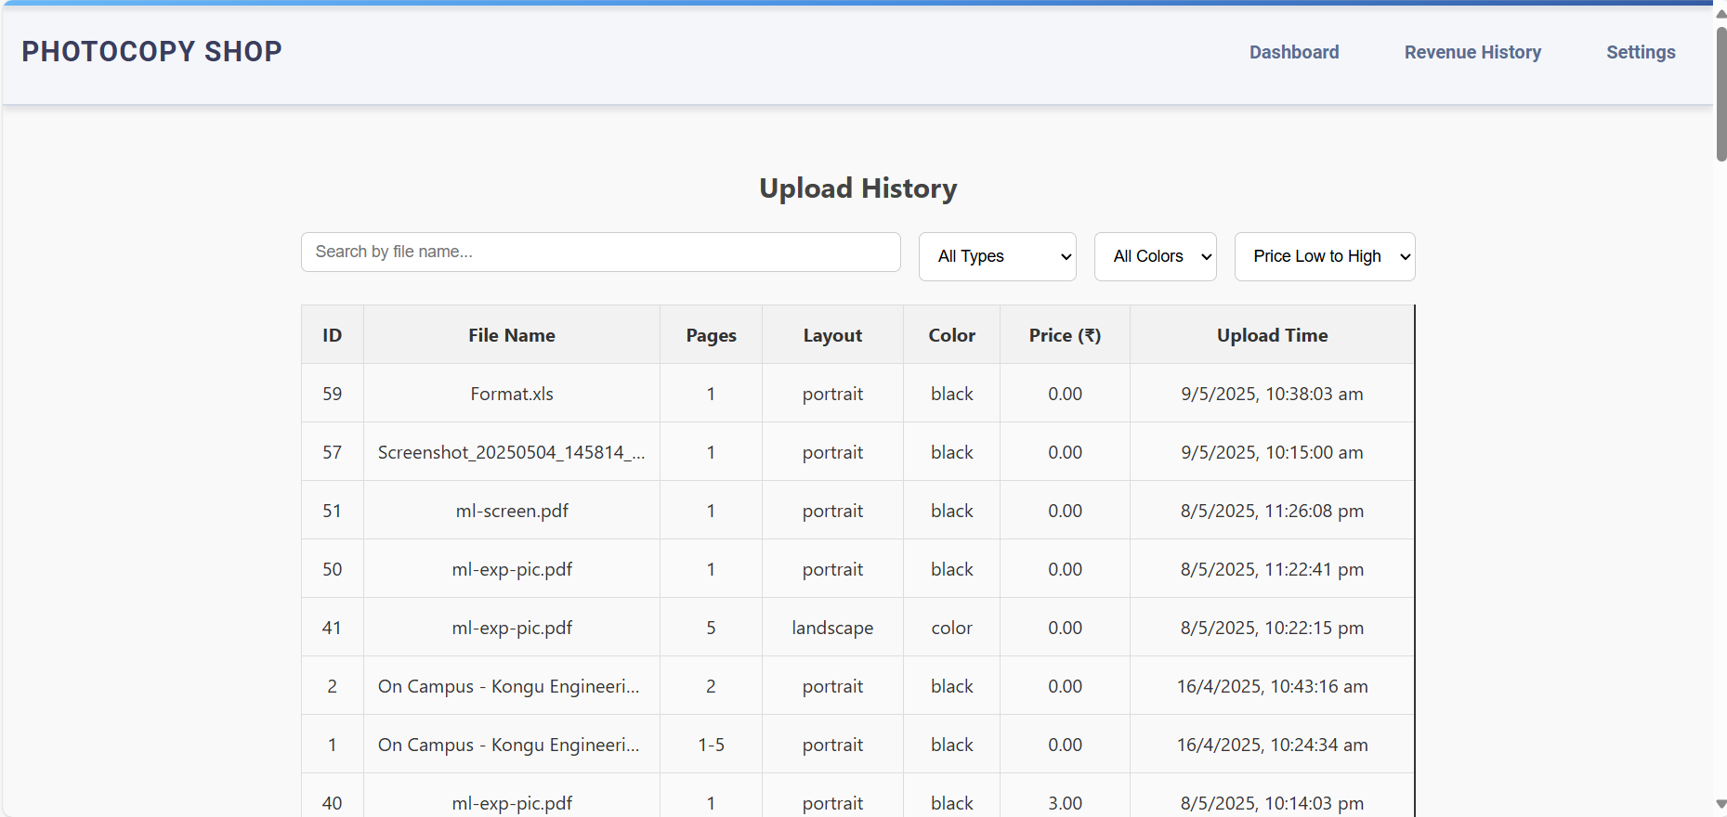
IMPLEMENTATION

Slide 12
RESULTS
QR Code-based Connection Module
Successfully established secure customer-shop connection via QR code scanning.
Instant File Transfer Module
Enabled real-time file transfers between customer and shop systems without delay.
Offline Support Module
Achieved complete functionality over local network without internet dependency.
Queue Management Module
Implemented file queuing system to manage multiple customer requests efficiently.
Shop Owner Control Panel
Developed a user-friendly dashboard to manage files, print jobs, and customer queue.
Easy Setup & Deployment Module
Packaged the system into a single-click Electron app for seamless installation and use.

